Slide 1
CSE101-lec#8
Designing Structured Programs

Slide 2
Outline
Designing structured programs in C:
  Counter-controlled repetition
  Sentinel-controlled repetition
  Top down design and stepwise refinement
Avoid :goto

Slide 3
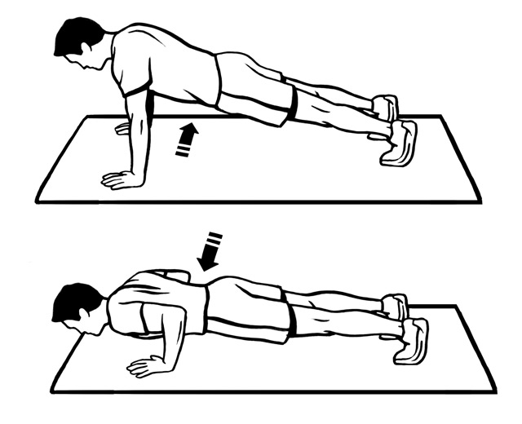


Example
Counter Controlled
Sentinel Controlled
Do TEN push ups imposes a count condition

Slide 4
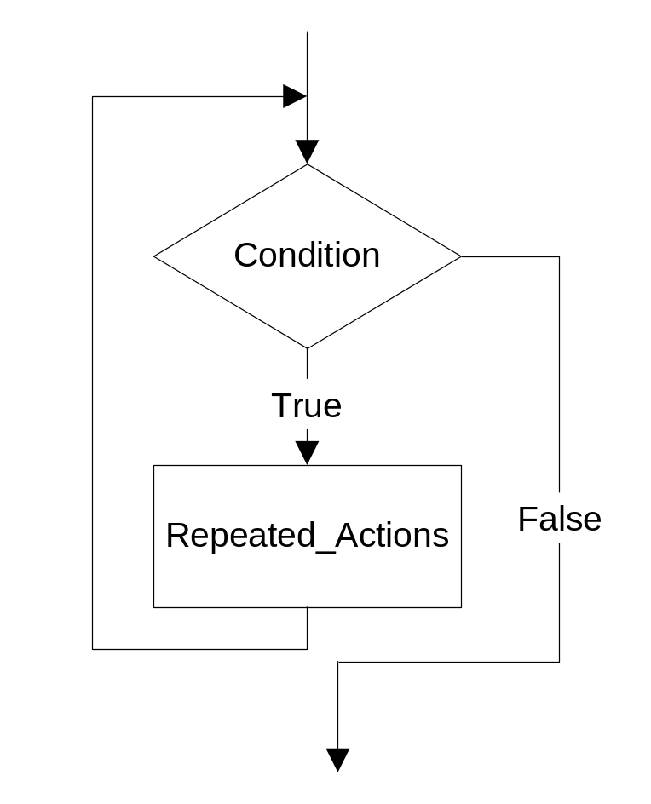
Repetitions
The while loop repeats untill the condition is true.
The condition to stop the repeated loop depends upon the output required.

Slide 5
Formulating Algorithms
(Counter-Controlled Repetition)
Counter-controlled repetition
  Loop repeated until counter reaches a certain value.
  Counter is a variable used to specify the number of times a set of statements should execute.
  Definite repetition: number of repetitions is known
Example (class-averaging problem)
A class of ten students took a quiz. The marks (integers in the range 0 to 100) for this quiz are available to you. Determine the class average on the quiz

Slide 6
Class-averaging Problem
Pseudocode:
  Set total to zero
  Set grade counter to one
  while grade counter is less than or equal to ten
    Input the next grade
    Add the grade into the total
    Add one to the grade counter
  Set the class average to the total divided by ten
  Print the class average

Slide 7
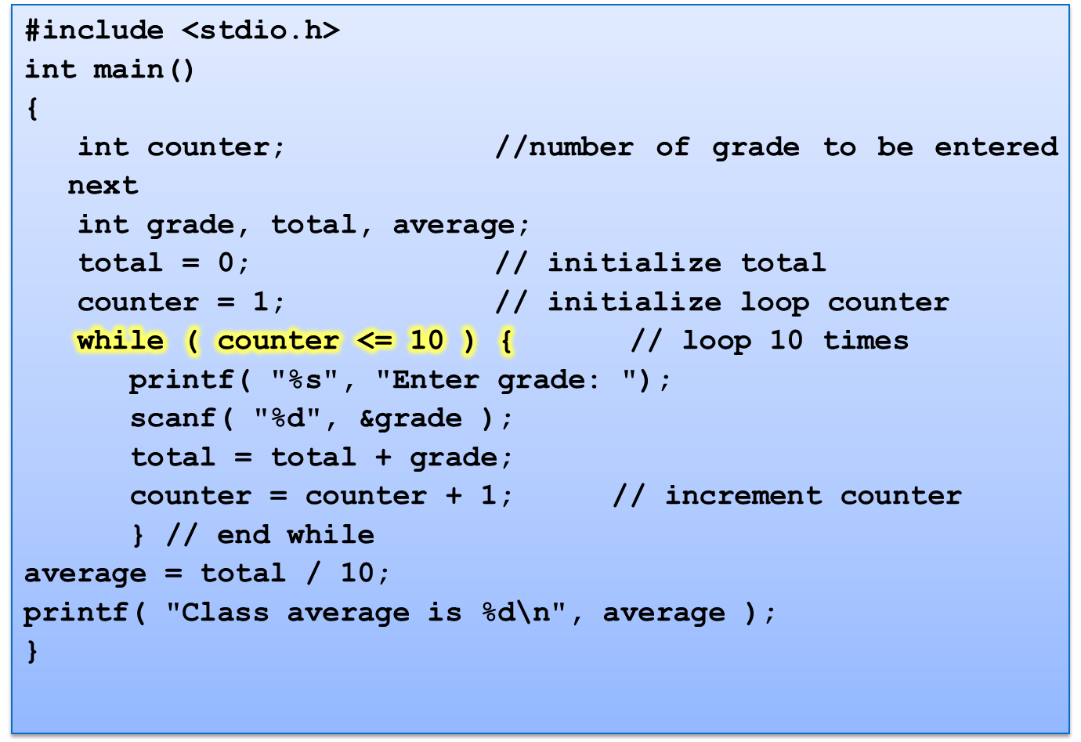

Slide 8


Enter grade: 98
Enter grade: 76
Enter grade: 71
Enter grade: 87
Enter grade: 83
Enter grade: 90
Enter grade: 57
Enter grade: 79
Enter grade: 82
Enter grade: 94
Class average is 81
Quick yak:
Ask students to create a program to calculate batting average of their favorite batsman in IPL 2014

Slide 9
Formulating Algorithms with Top-Down, Stepwise Refinement
Reconsider class-averaging problem:
  Develop a class-averaging program that will process an arbitrary number of grades each time the program is run.
  Unknown number of students.
  How will the program know when to end?
Use sentinel value
  Also called signal value, dummy value, or flag value
  Indicates “end of data entry.”
  Loop ends when user inputs the sentinel value
  Sentinel value chosen so it cannot be confused with a regular input (such as -1 in this case)

Slide 10
Formulating Algorithms with Top-Down, Stepwise Refinement
Top-down, stepwise refinement
  Begin with a pseudocode representation of the top:
    Determine the class average for the quiz
  Divide top into smaller tasks and list them in order:
    Initialize variables
    Input, sum and count the quiz grades
    Calculate and print the class average
Many programs have three phases:
  Initialization: initializes the program variables
  Processing: inputs data values and adjusts program variables accordingly
  Termination: calculates and prints the final results

Slide 11
Formulating Algorithms with Top-Down, Stepwise Refinement
Refine the initialization phase from Initialize variables to:
    Initialize total to zero
    Initialize counter to zero
Refine Input, sum and count the quiz grades to
    Input the first grade (possibly the sentinel)
    While the user has not as yet entered the sentinel
    Add this grade into the running total
    Add one to the grade counter
    Input the next grade (possibly the sentinel)

Slide 12
Formulating Algorithms with Top-Down, Stepwise Refinement
Refine Calculate and print the class average to
    If the counter is not equal to zero
    Set the average to the total divided by the counter
    Print the average
    else
    Print “No grades were entered”

Slide 13
Refined Pseudocode for Class-averaging Problem
Pseudocode:
Initialize total to zero
Initialize counter to zero
Input the first grade
While the user has not as yet entered the sentinel
  Add this grade into the running total
  Add one to the grade counter
  Input the next grade(possibly the sentinel)
If the counter is not equal to zero
  Set the average to the total divided by the counter
  Print the average
Else
  Print “No grades were entered”

Slide 14
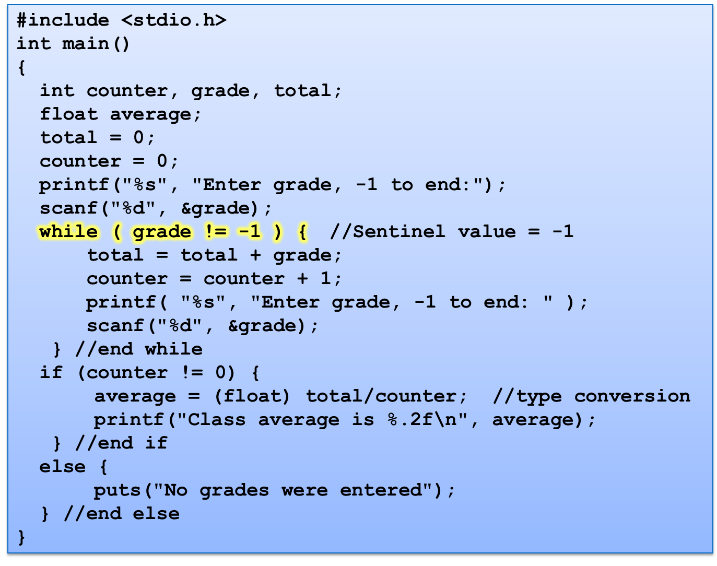

Slide 15
Enter grade, -1 to end: 75
Enter grade, -1 to end: 94
Enter grade, -1 to end: 97
Enter grade, -1 to end: 88
Enter grade, -1 to end: 70
Enter grade, -1 to end: 64
Enter grade, -1 to end: 83
Enter grade, -1 to end: 89
Enter grade, -1 to end: -1
Class average is 82.50
OR
Enter grade, -1 to end: -1
No grades were entered

Slide 16
A Structured program should be ________
a) Secure
b) Sequential
c) Ordered
d) Simple

Slide 17
What is the correct syntax of for loop?
a) for(initialization;condition;update)
b) for(initialization,condition,update)
c) for(condition;initialization;update)
d) for(initialization;condition;)

